Slide 1
Probabilistic Data Management Project
Title: Kidney Creatine Analysis
#Group17

Slide 2
Group Members
Raghava Jaya Sai Rakesh Kota – 811300200 (rkota1@kent.edu)
Shashank Uppalamurty - 811286818 (suppalam@kent.edu)
Praveen Kumar Botta – 811324631 (pbotta1@kent.edu)
Venkatesh Reddy Kesari – 811313636 (vkesari1@kent.edu)
Sravani Cheepilla – 811290164 (Scheepil@kent.edu)
Sai Krishna Nalluri – 811286663 (Snallur2@kent.edu)

Slide 3
Introduction
Kidney Creatine Analysis is web application which will help to forecast the fluctuations in the creatine levels based on diet of patients. Through this website the user can check the eligibility for the donation of their kidney.
There are some existing websites which will do the same functionalities but those are not user friendly because the terminologies they used in that is not understandable for every user. Moreover, to perform this operations we have to deal with uncertain data. So, in our project we have used some topics which are related to the PDM.

Slide 4
Problem Statement
Problem Statement: For the patients who are suffering with the diabetes and kidney issues they should follow some diet which was recommended by the doctors. In that they must control their salt intake, water intake, bmi etc. But some times it become difficult to users to predict there fluctuations in their creatine levels. Moreover the existing websites are not having good interface. Those are getting issues with the accuracy and major complaint is those are failing in deal with uncertainty of the data.

Slide 5
Proposed Solution
At first, we tried to enhance the user interface by asking some simple values like
Salt intake
Water Intake
BMI
Physical Exercise per day
BMI etc.
To deal with uncertainty we have used Bayesian algorithm and Marvok model. Because the values having so many uncertainties.

Slide 6
Dataset
To deal with this problem we have used a dataset named “Diabetes Health Indicator dataset”.
This is the best dataset because, this dataset is including some metrics like blood glucose levels, BMI, and hypertension status and these are closely linked to kidney and their creatine levels. So, through this dataset it is easy to access the potential risk in fluctuations of creatine.
This dataset will help to identify the complex interdependencies between inputs like salt intake, water intake etc.

Slide 7
Dataset
This dataset is fit for PDM because the patient's data will always uncertain and those are very noisy. This dataset will also allow classification od patient states (normal, at – risk, or critical).
For this initially we have decided to use Bayesian Network but later we used Markov model. This Markov model offers structured way to handle variability and gaps in health data.
Mainly this dataset is used to train the model.

Slide 8


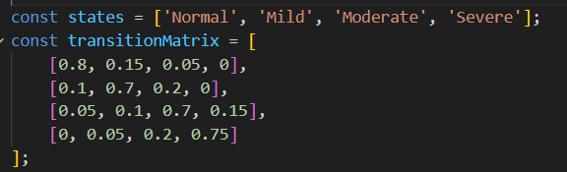

Methodology
In this I have used Markov Model because this is a statistical model, and it used matrix representation to represent the transitions between different states. To check Accuracy we used “Random Forest Model”.

Slide 9
Methodology
From the above figure we can say that each row is having different status.
For example Row (0.8, 0.15, 0.05, 0) this indicates Normal
So in these values
0.8 – 80% chance of staying in Normal State
0.15 – 15% chance of transition to Mild State
0.5 – 5% chance of transition to Moderate State
0 – 0% chance of transition to Severe state

Slide 10
How It Works
Lets imagine some inputs like Salt intake 4grams, BMI 27, Diabetes Status – None, Ahe 58
So based on those values
Salt intake > 5 (Not Satisfied) stays Normal
Age > 60 (Not Satisfied) Stays Normal
BMI > 29 (Not satisfied) Stays Normal
Diabetes Type – None – Stays Normal

Slide 11
How It Works
So Final State = Normal
Then this will throw a random probability like “0.80”
Then it will check with the cumulative probabilities which are for normal. As I mentioned earlier Row 1 represents normal[0.8, 0.15, 0.05, 0]
By doing sum of above values of Row 1 the cumulative probability will be 1 so, 0.8 < 1.0 (Satisfied) Sticks to the Current State.

Slide 12
Challenges
At first, we tried to implement the library which is related to the Bayesian model, but we failed in that because of some limitations in that library.
Then we face issues in structing the Matrix
Solutions:
Instead of Bayesian we used Markov methods because through this we can change the states easily and it will be in matrix format which will give more clear vision of changes of states.

Slide 13
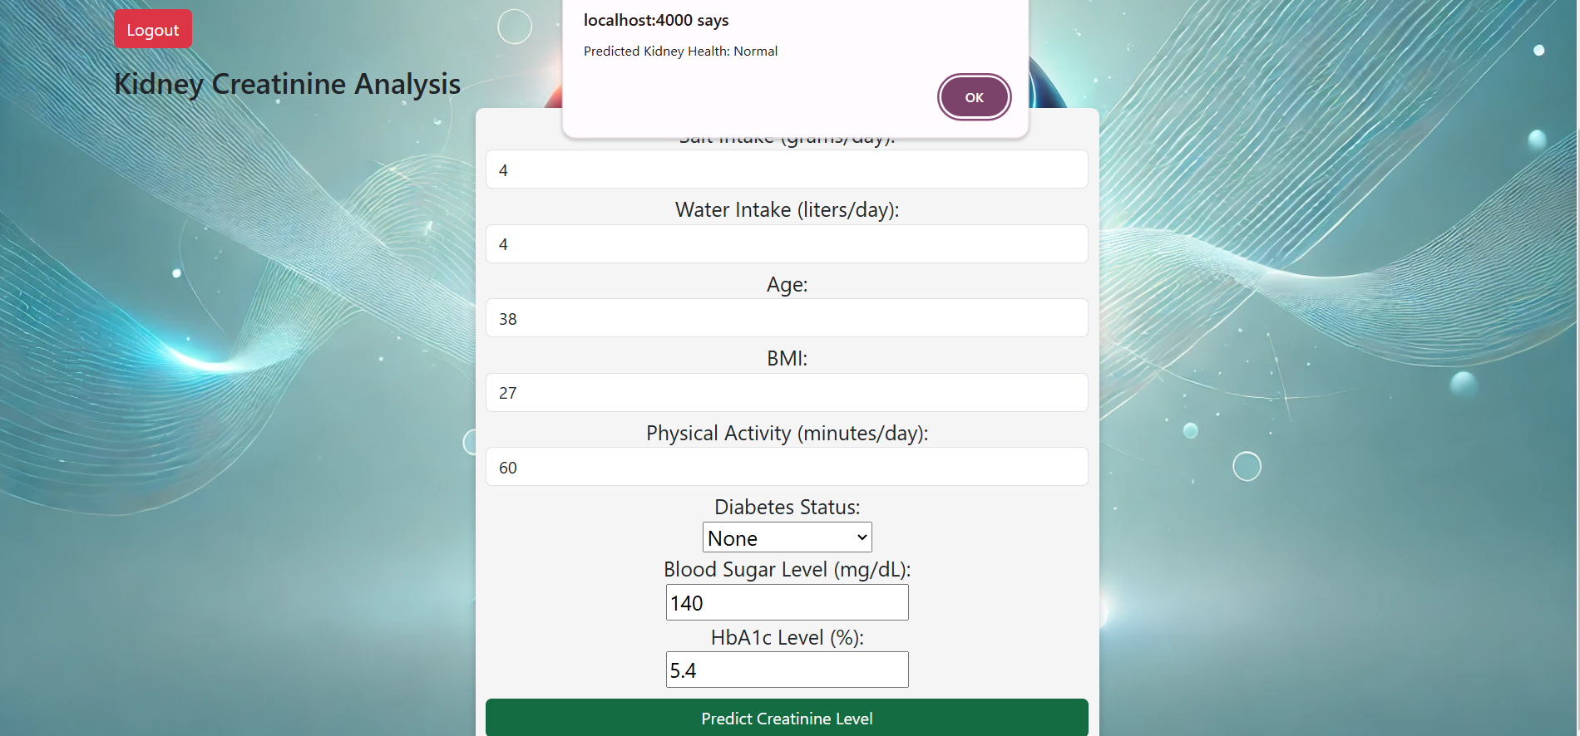
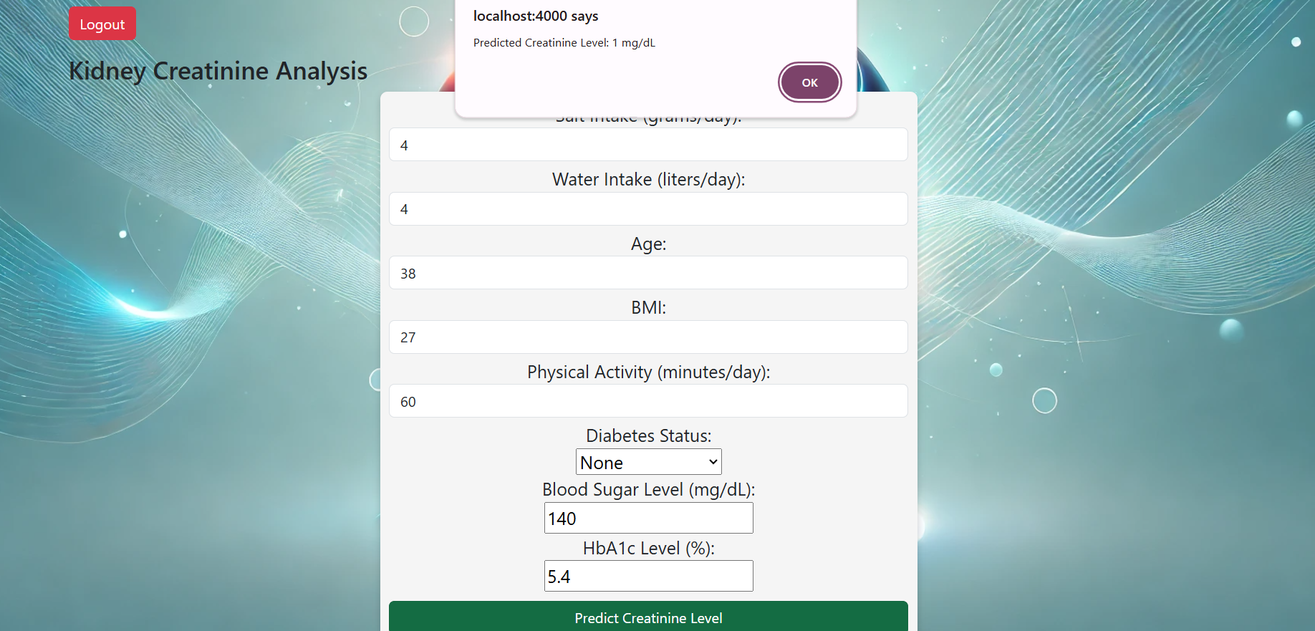
Results

Slide 14
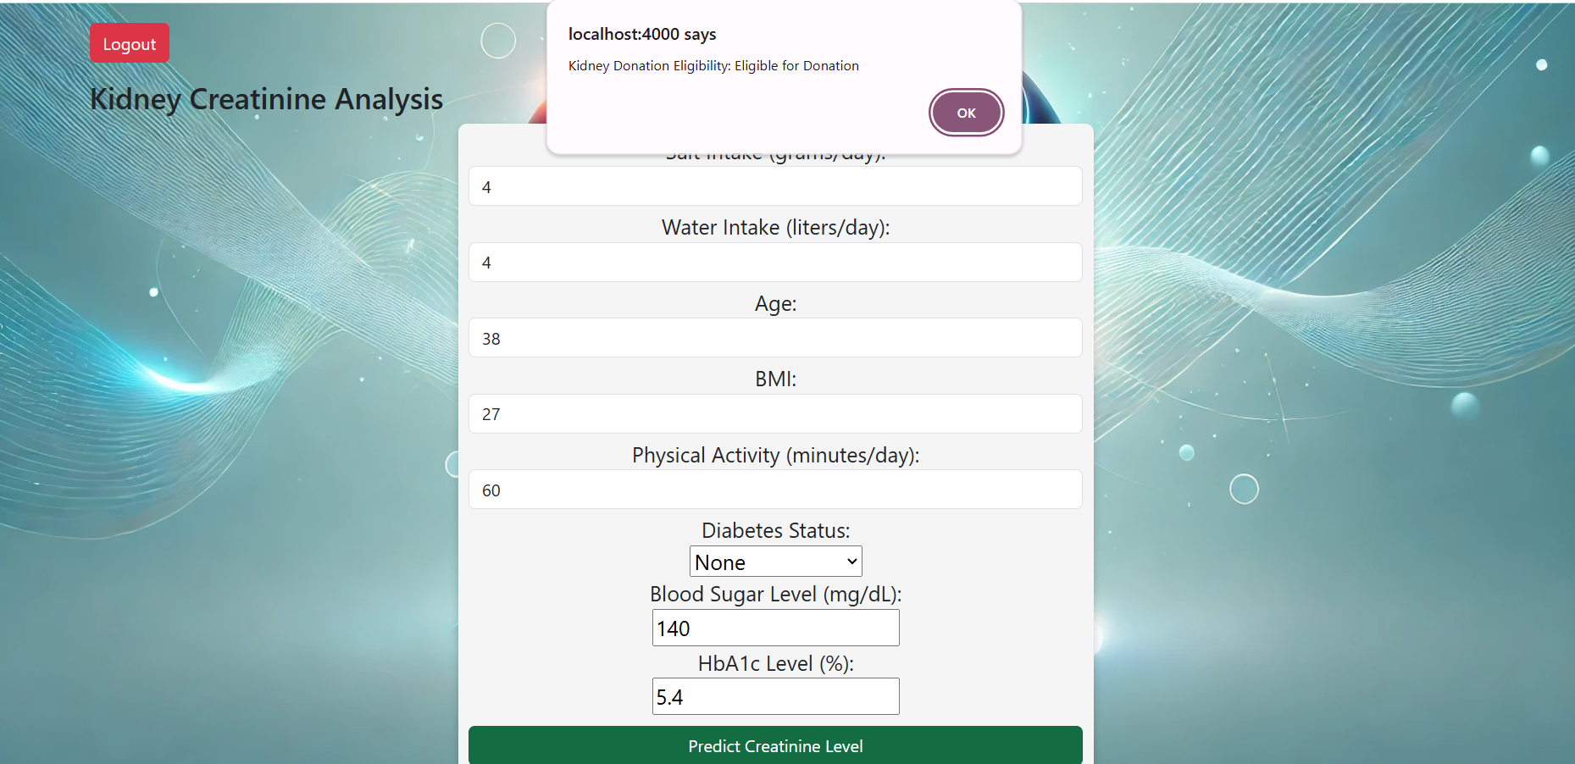
Results

Slide 15
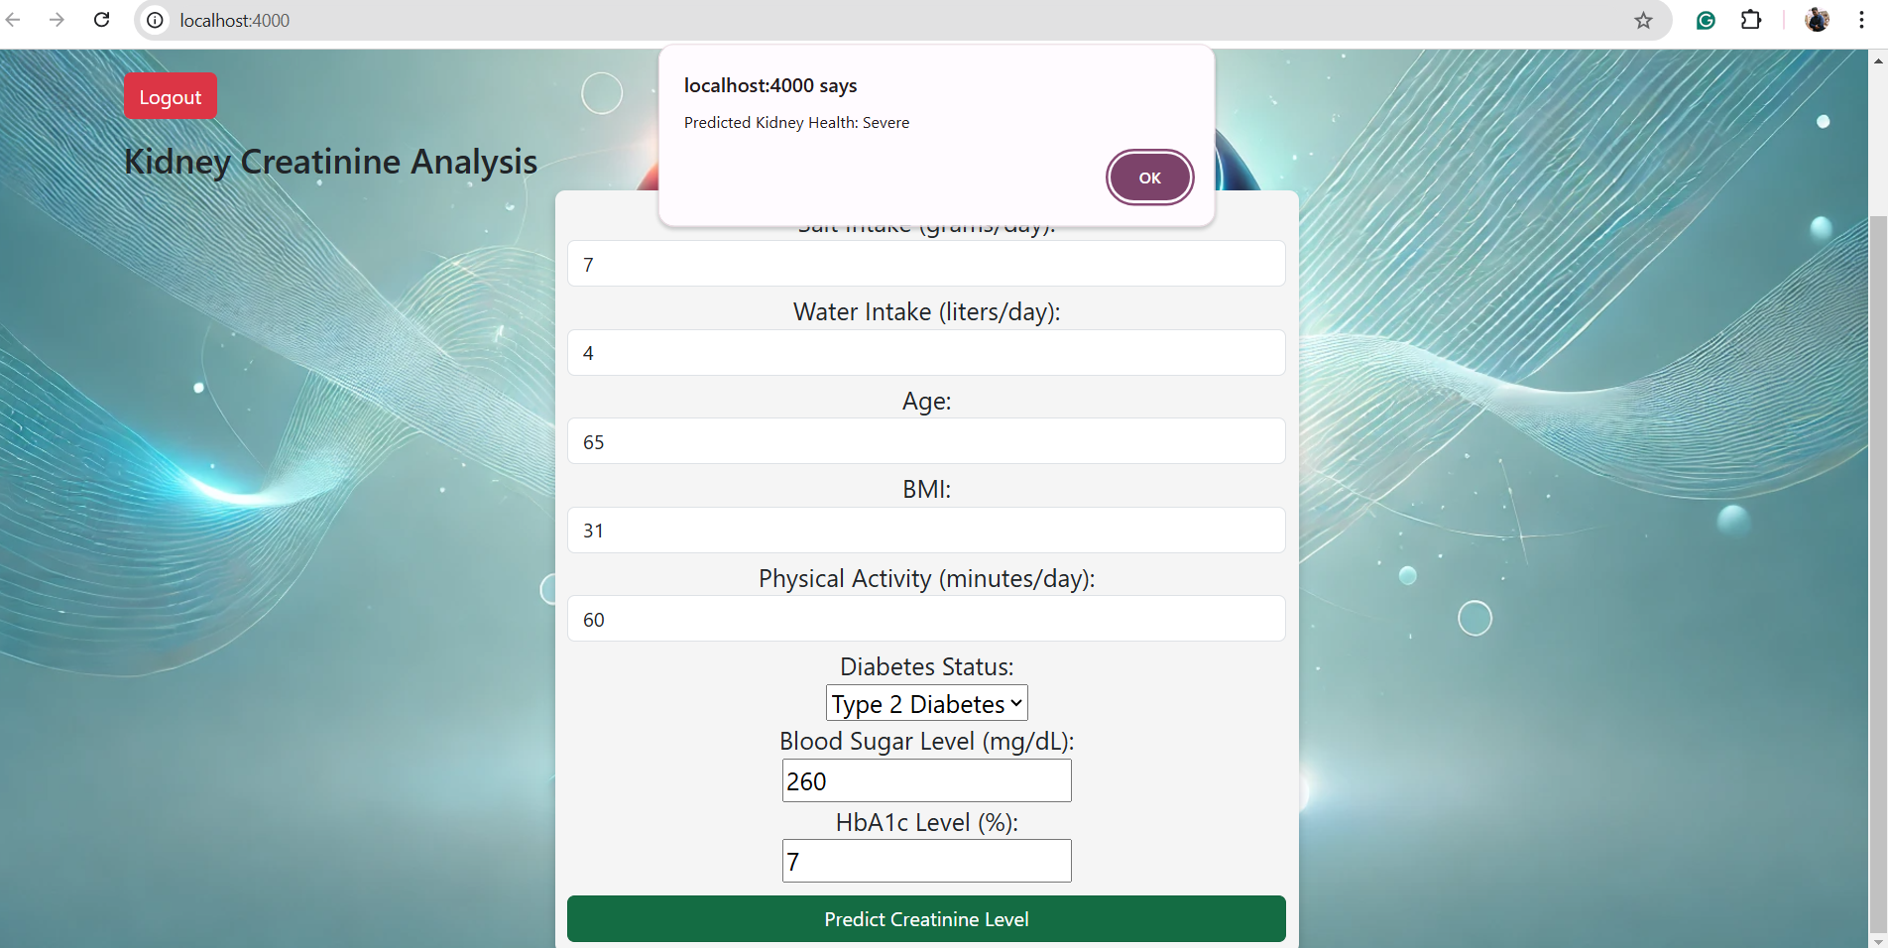
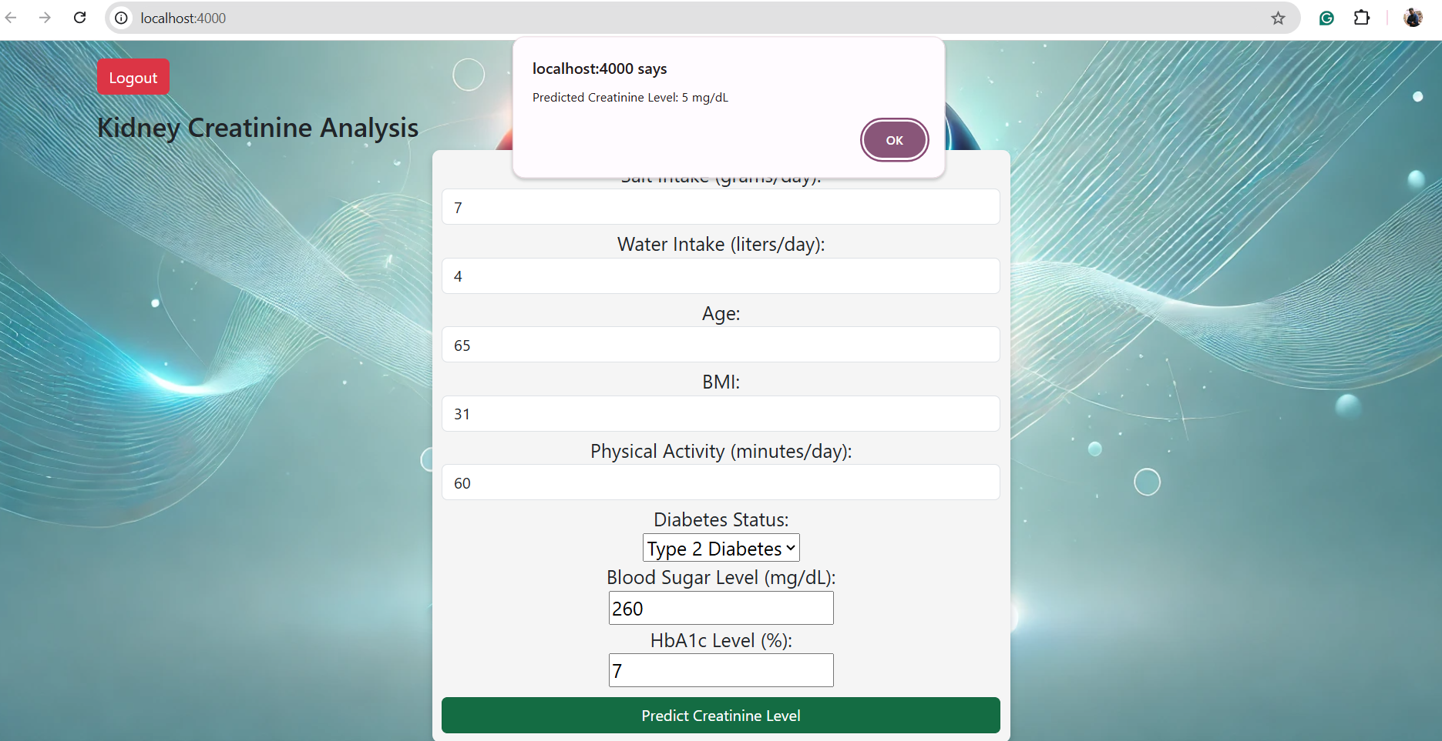
Results

Slide 16
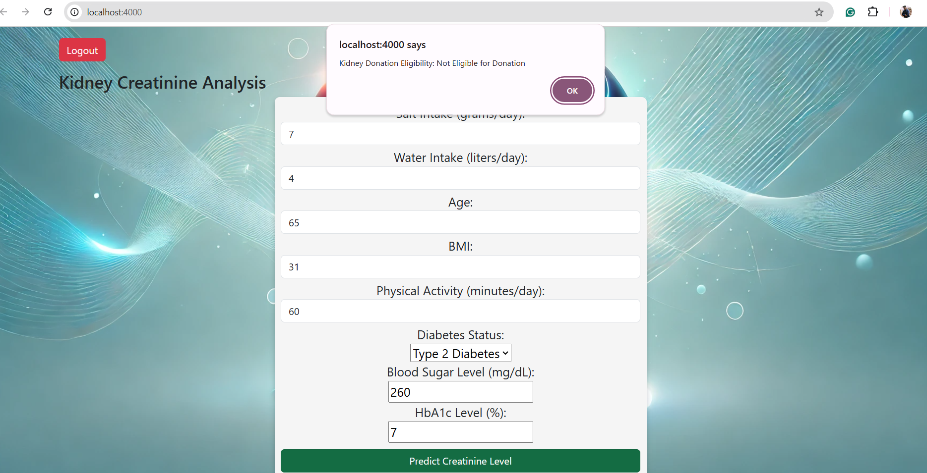
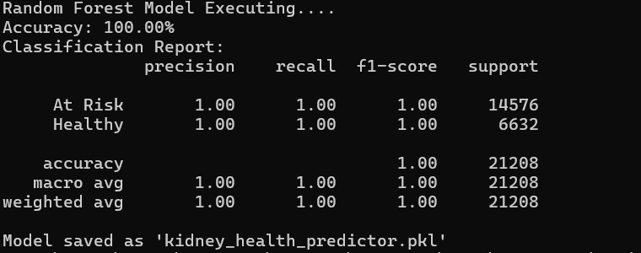
Results

Slide 17
Future Scope
In future we would like to introduce “Doctor Login” to see the patients' conditions which will help to give the better treatment to the users.
We will implement AI to predict the possible “Organ Damage” and also Kidney match for the particular user.
We would like to create a new database which will store the previous reports of the users and their data.

Slide 18
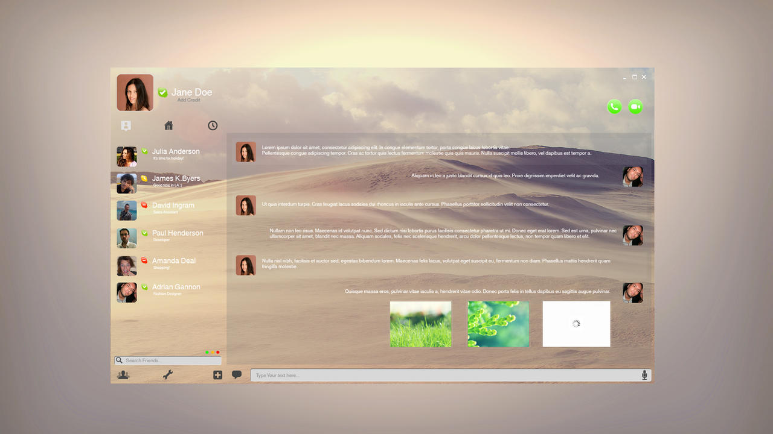
Are You Ready to Explore Our Application?
This Photo by Unknown Author is licensed under CC BY-NC-ND

Slide 19
Conclusion
I would like to conclude for this we have Markov model which is concept of Probabilistic Data Management we got a good accuracy values and we made it user friendly means understandable to the users.
Trough this project we have learned more about Markov Model and structuring the Matrix.
Moreover, we can even use Bayesian network library instead of Markov because we think structuring matrix is complex. Because in further improvements Bayesian model helps in deal with the complex relationships.

Slide 20

Thank you

